Slide 1
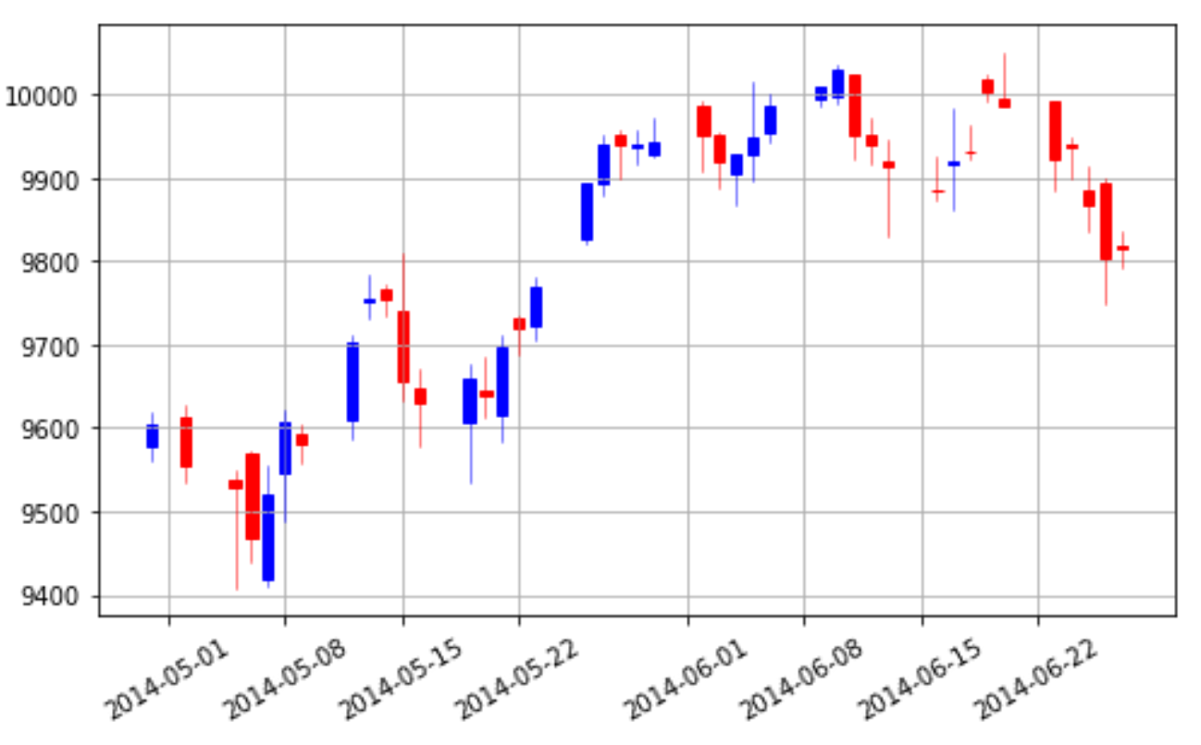

Candlestick Chart

Slide 2

How to install mpl_finance

Slide 3
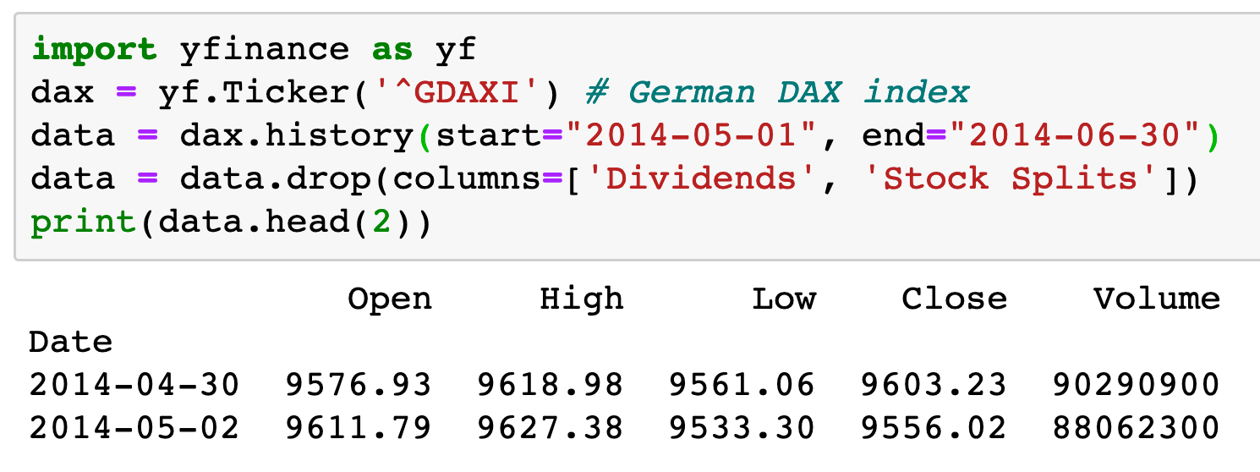

Slide 4
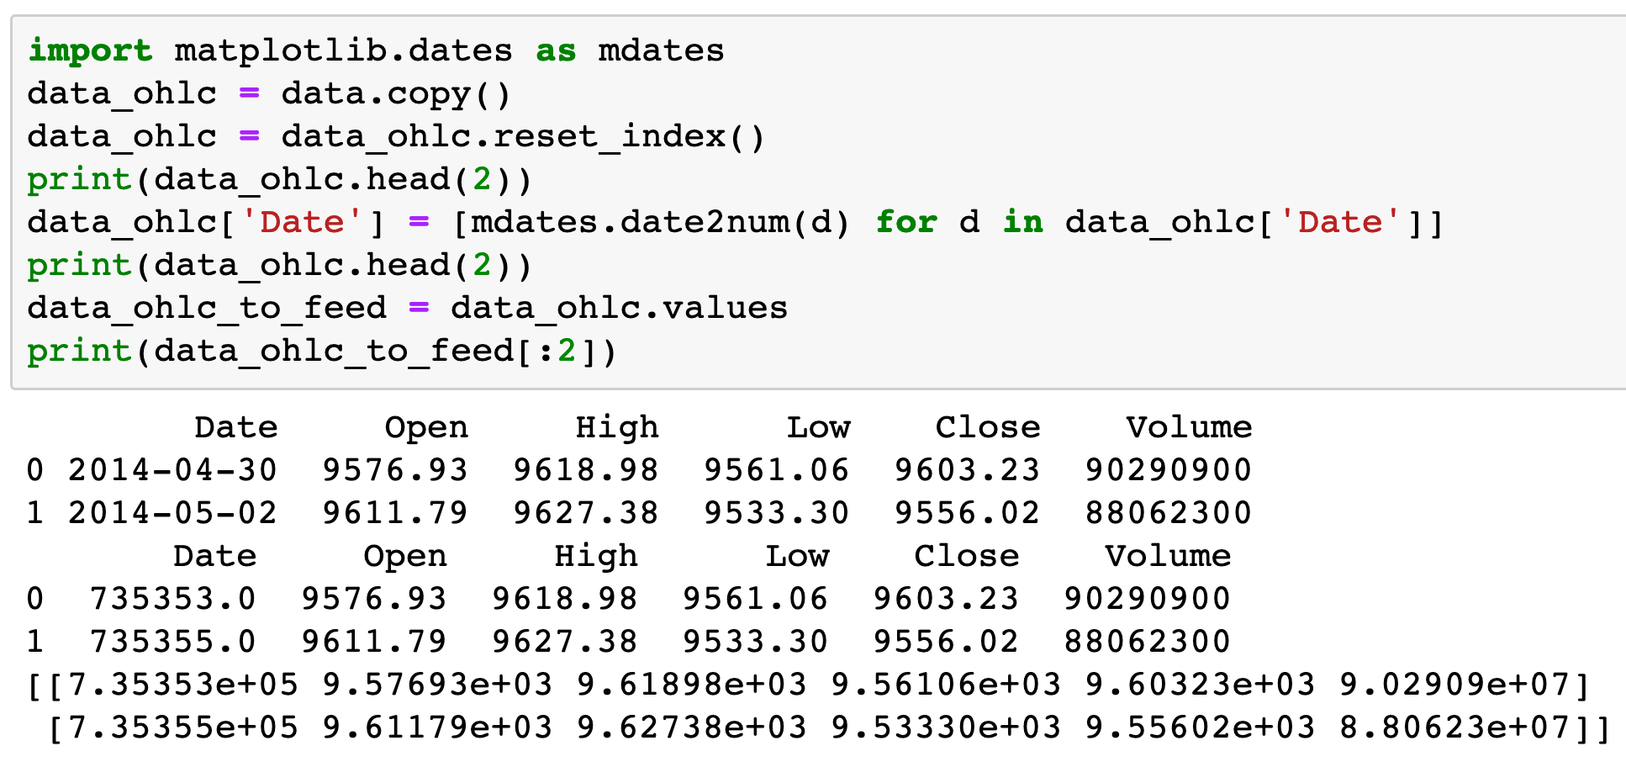

Slide 5
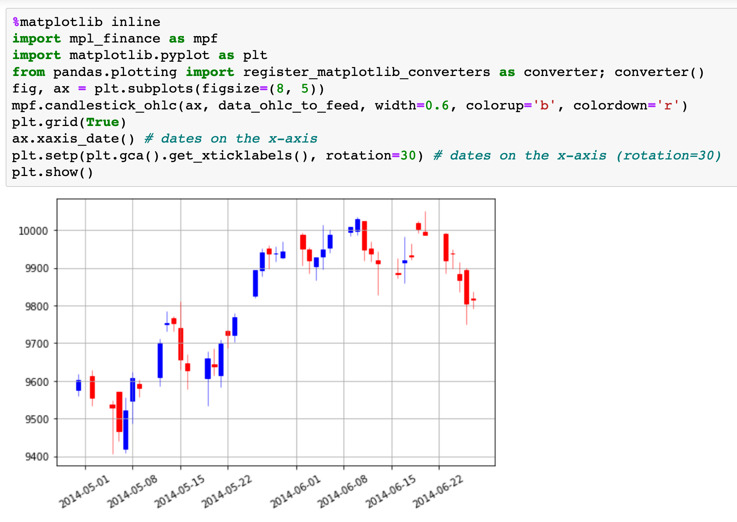

Slide 6
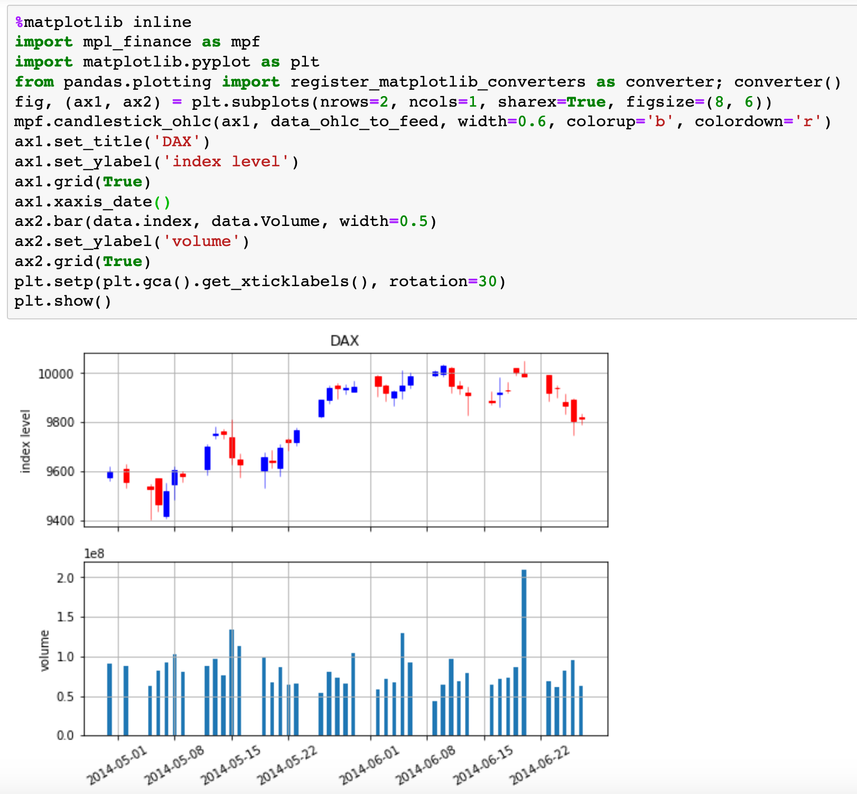

Slide 7
Reference
youtube
github
ppt

